Slide 1

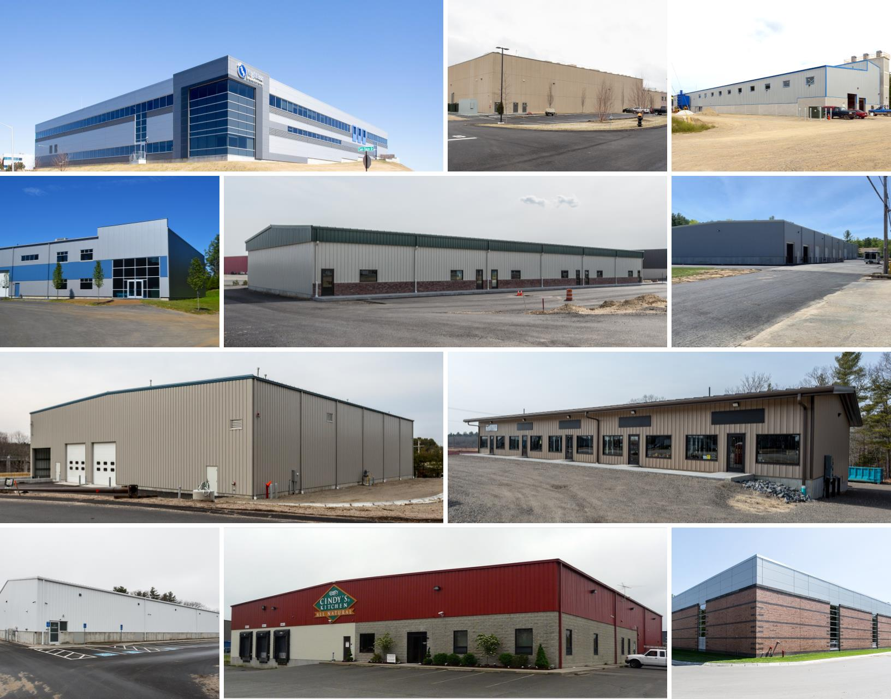
Market Overview
Boston - MA
Industrial
November 2025
Data as of 11/20/2025

Slide 2
Supply, Demand and Vacancy
Forecast

Slide 3
Net Absorption SF
Forecast

Slide 4
Net Absorption by Subtype

Slide 5
Net Delivered SF
Forecast

Slide 6
Construction Starts

Slide 7
Under Construction SF

Slide 8
Vacancy by Subtype
Forecast

Slide 9
Market Asking Rent Growth (YOY)
Forecast

Slide 10
Market Asking Rent Per SF
Forecast

Slide 11
Market Cap Rate
Forecast

Slide 12


